Slide 1
南阳Google技术用户组第二次动员大会
站在巨人的肩膀上，一起展望技术的未来
南阳Google技术用户组创始人：
王耀宽，程路，王琳
南阳Google技术用户组联系邮箱：
chenglu@gtugs.org

Slide 2
Header Example: Arial Font, 24pt
Text Example, 20 point
  First-level bullet, 18 point
    Second-level bullet, 16 point
      Third-level bullet, 14 point
        Fourth-level bullet, 12 point

Slide 3
Quote slide
“The expectation of today’s savvy online user is that it should be easy, it should be convenient and it should be better than a face-to-face experience; that's what we’ve strived for.”
Catherine Palmieri,
Managing Director, Citibank.com
Source: http://www.cashedge.com/pressRoom/news_070104_bst.html
Notes:
I’m looking for a Citigroup quote here to use, if possible…

Slide 4
List in a table
1 | Advertising should be measurable, accountable, and optimizable
2 | You should only pay as much as you have to and you should get what you pay for
3 | Advertising should be flexible. You should be able to start, stop, or cancel your media buy at any time you choose
4 | Your communications should be asset-based not campaign-based

Slide 5


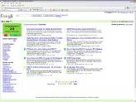

Google’s mission
To organize the world’s information and make it universally accessible and useful.
Online content
Billions of web pages
Offline content
Billions of items becoming indexed
Notes:
Historically, all digital, already on the web; but there is a huge amount of information not currently on the web in books
So, 2004 Google started to index this content through the launch of Google Book Search

Slide 6
Thank You!
Q&A

Slide 7
Divider slide
Blue

Slide 8
Divider slide
Green

Slide 9
Divider slide
Yellow

Slide 10
Divider slide
Red

Slide 11



For use on web pages
For general use
If in doubt, use this
Against flat colours only

Slide 12















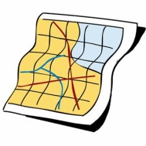

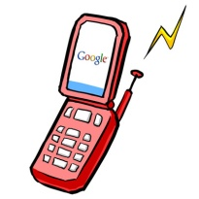
















Alerts
Blogger
Blog Search
Book Search
Calendar
Catalogues
Checkout
Code
Co-op
Desktop Search
Directory
Docs &
Spreadsheets
Earth
Finance
Froogle
Gmail
Google Labs
Groups
Images
Local
Maps
Maps for Mobile
Mobile
News
Pack
Picasa
Scholar
Talk
Toolbar
Translate
SketchUp
SMS
Specialized
Searches
Video
Web Accelerator
Web Search
YouTube

